Slide 1


Big Data is a Big Deal!
Sushant Ahuja, Cassio Cristovao, Sameep Mohta
Capstone Project 2015-2016
Computer Science Department
Texas Christian University

Slide 2

Agenda
Project Overview and Goals
Apache Hadoop
Apache Spark
Initial Testing
Recommender System
Clustering
Challenges
Questions
NTASC '16
Notes:
Needs to be modified

Slide 3
Project Background
Big Data Revolution
  Phones, Tablets, Laptops, Computers
  Credit Cards
  Transport Systems
  0.5% of data stored is actually analyzed¹
Smart Data (Data Mining and Visualization of Big Data)
    Recommendation Systems
        Netflix, Amazon, Facebook
    1. Source: https://www.technologyreview.com/business-report/big-data-gets-personal/ Published in May 2013
NTASC '16

Slide 4


Goals
Performance Analysis
  Hadoop vs Spark
    Speed
    Size of data
    Efficiency
Validate feasibility
Predict data - recommendation systems
  ‘Big Data’ ‘Smart Data’
NTASC '16
Notes:
Needs to be modified

Slide 5

Our Cluster
Hadoop and Spark
  2 Clusters: 3 nodes each
    8 GB RAM
    500GB HDD
    Ubuntu 15.04
  Manager-Worker Architecture
    1 Manager
    2 Workers
M
W
W

Slide 6
Project Technologies
Java Virtual Machine
Eclipse IDE
Apache Hadoop
Apache Spark
Maven for Hadoop and Spark
Mahout on Hadoop systems
MLlib on Spark systems
NTASC '16

Slide 7
Apache Hadoop
Framework for large-scale, data-intensive deployments
Open-source
MapReduce – Stream I/O style of data processing, created by Google
  Map – Filtering input line by line
  Reduce – Collecting and processing filtered data
Write-once storage infrastructure
NTASC '16

Slide 8
Apache Hadoop
4 Dimensions – Volume, Velocity, Variety, Veracity
Both Structured (converted) and Unstructured
HDFS – Breaks up input data – Blocks
  Stores it on compute nodes (Parallel Processing)

Slide 9
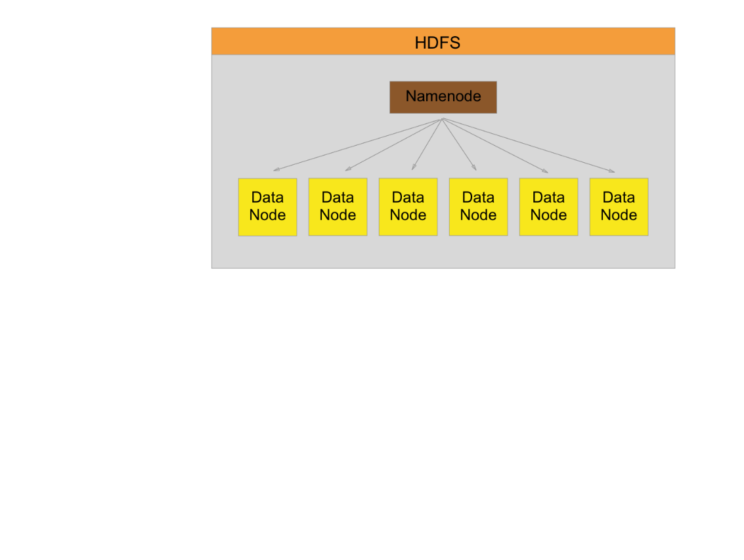
HDFS Segmentation

Slide 10
Hadoop MapReduce
Map Phase
  Splits input data-set into chunks
  Parallel processing - blocks
  Sorts the output
Reduce Phase
  Input from map phase
  Summary operation
  Output stored back in HDFS

Slide 11
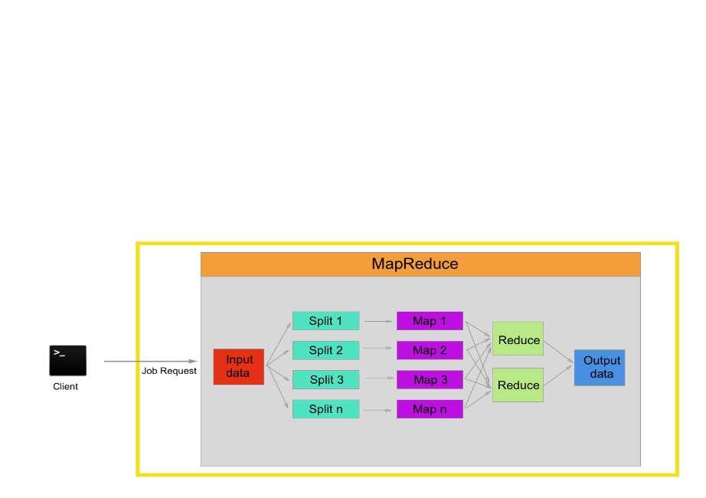
Hadoop Map/Reduce

Slide 12
Apache Spark
Open-source
Supports MapReduce
Lazy (on demand) evaluation
In-memory storage and computing
Offers APIs in Scala, Java, Python, R, SQL
Built-in libraries

Slide 13
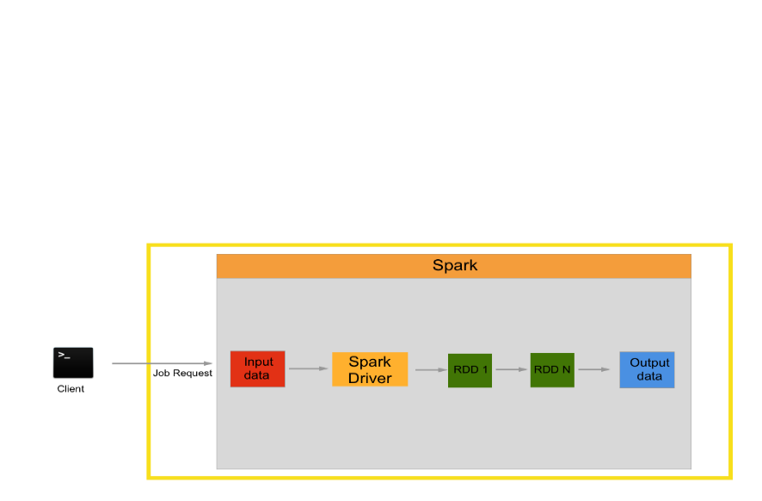
Apache Spark
RDD – Resilient Distributed Dataset

Slide 14
Hadoop or Spark?
NOT mutually exclusive
Database – HDFS or others
Rate of processing data
Third-party machine-learning library
Non-commercial, open-source

Slide 15
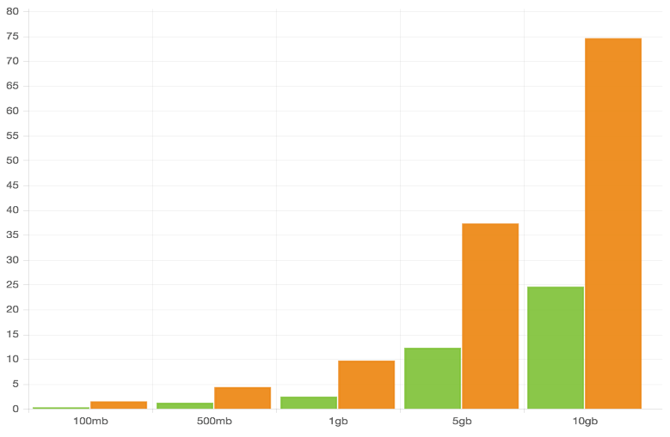
Word Count
Spark
Hadoop
Time (in minutes)
Size of the text file

Slide 16
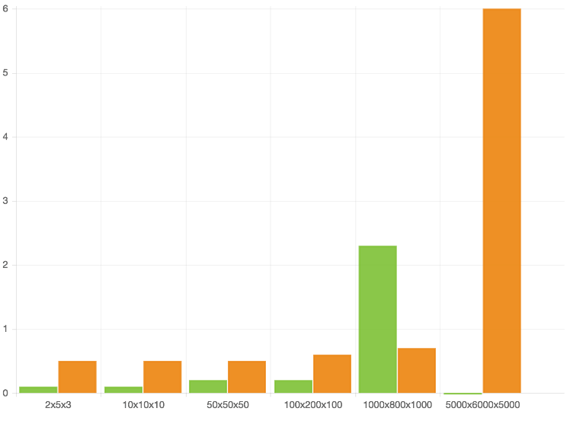
Matrix Multiplication
Spark
Hadoop
Time (in minutes)
Size of the Matrices

Slide 17
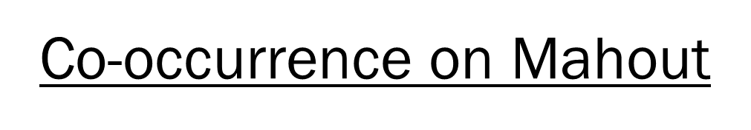
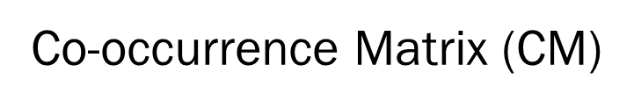
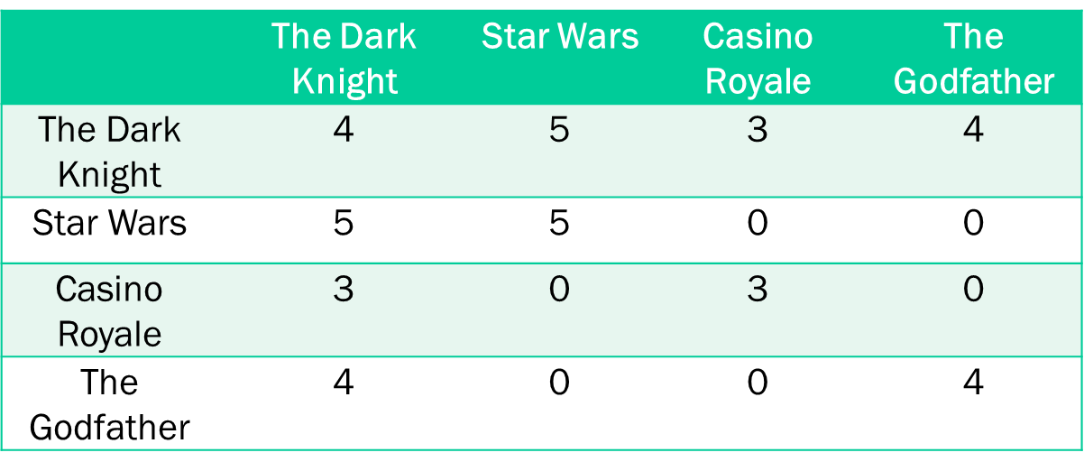


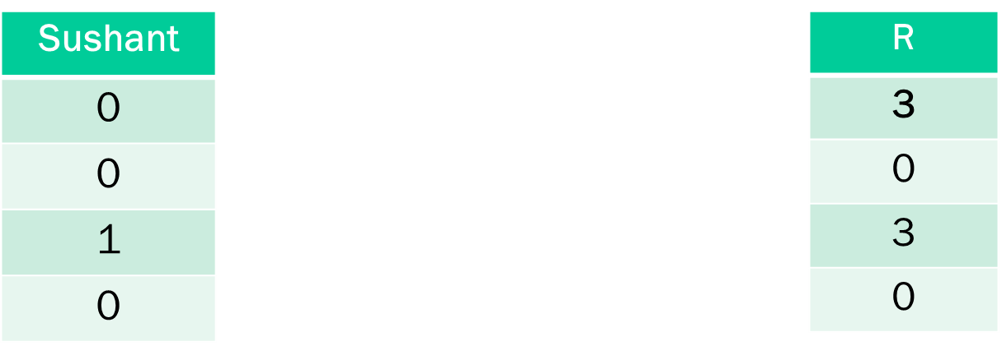
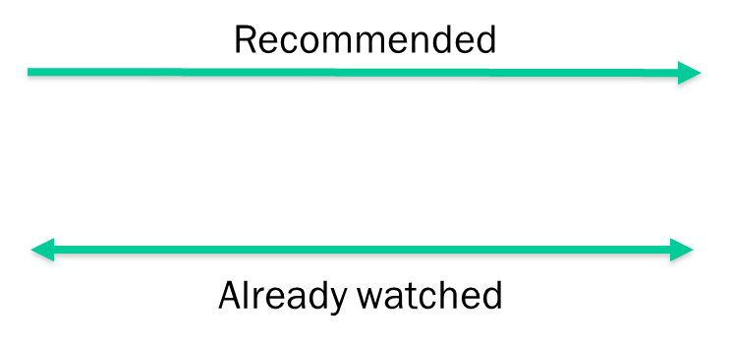

Movie Recommender-Hadoop

Slide 18
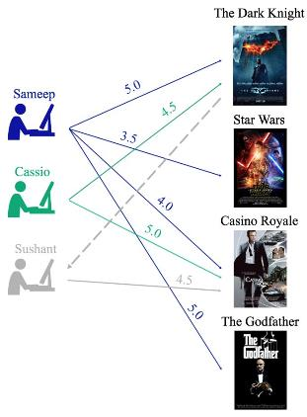

Movie Recommender-Spark
Collaborative Filtering

Slide 19
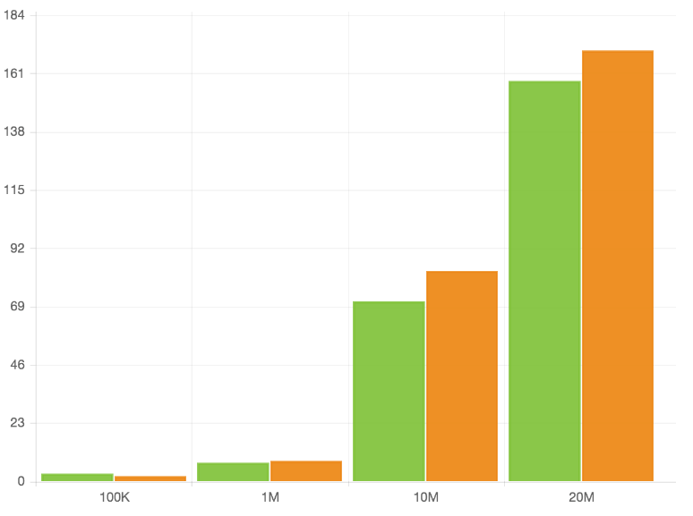
Recommender Comparison
Spark
Hadoop
Time (in minutes)
Number of records in the input file

Slide 20
K Means Clustering
k₁
Y
k₃
k₂
X
Source: www.liacs.nl/~putten/edu/dbdm05/Lecture3.ppt
Notes:
Basic concept and applications and graph

Slide 21
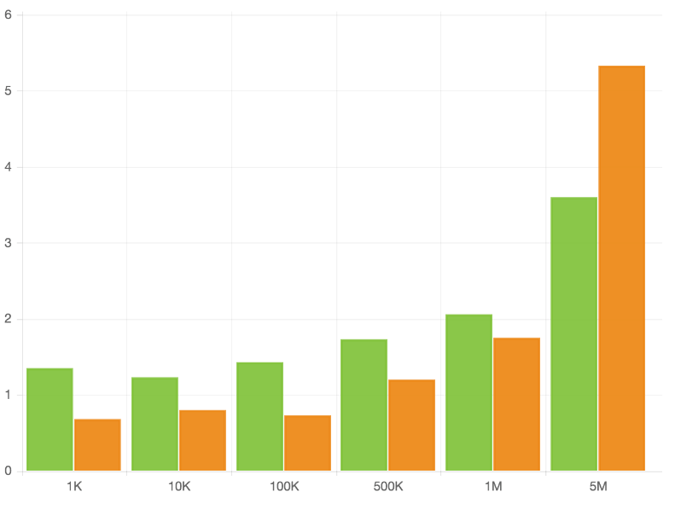
Clustering Comparison
Spark
Spark
Hadoop
Hadoop
Time (in minutes)
Number of records in the input file

Slide 22
Hadoop or Spark?
(Based on a cluster of 1 M and 2 W)
Hadoop – Huge datasets
Spark – Computational capability
Spark – Degrades on I/O swapping

Slide 23
Challenges
Multiple Reducer Problem
Amount of data
  Co-occurrence algorithm
  Dumping clusters: K-Means
Quality of Recommendations

Slide 24
Questions

